Slide 2
CONTENTS:
HISTORY
NEED OF HISTORY
SOURCES OF HISTORY

Slide 3
I MAKE HISTORY

Slide 4
I MAKE HISTORYN Karunambigai/Social/SNS ACADEMY

Slide 8
I MAKE HISTORY/Karunambigai/Social/SNS ACADEMY

Slide 9
I MAKE HISTORY/Karunambigai/Social/SNS ACADEMY

Slide 12
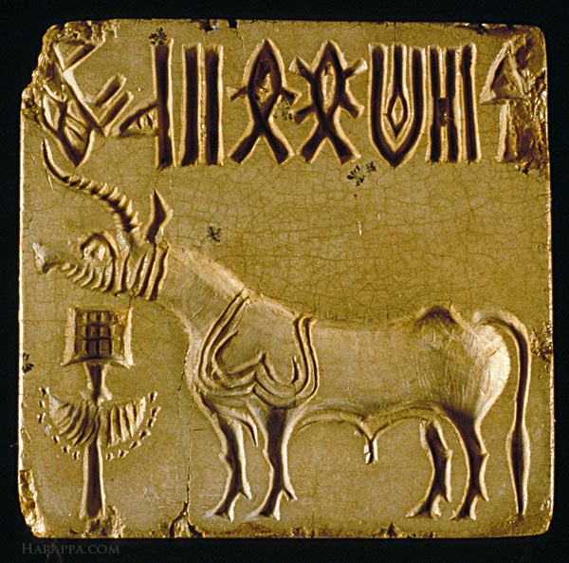
The first seals proper in the Aegean are encountered in EB II. Seals continue to be made down to the end of the Bronze Age. Seals would have played an important role in Aegean society and, as functional objects, they would have served three main purposes: securing, marking, and authorizing.

